Slide 1
Public Key Encryption (unit 4)

Slide 2
What Is Encryption and How Does It Work
Encryption is the process of transforming plaintext into ciphertext through the use of two important elements:
Algorithms — An encryption algorithm is a set of directions to help you solve a problem. More specifically, it’s a set of mathematical instructions and processes that serve a specific purpose. Some algorithms are designed to work in either private or public channels. So, you can have asymmetric or symmetric encryption algorithms.
Keys — A cryptographic key is a long, random and unpredictable string of letters and numbers that you use to encrypt or decrypt data. No matter whether you’re talking about asymmetric vs symmetric encryption, the keys are important to protect

Slide 3
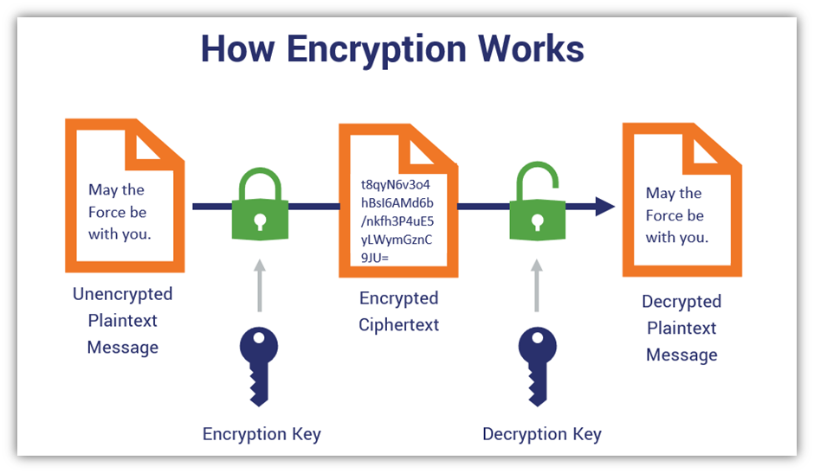

Slide 4
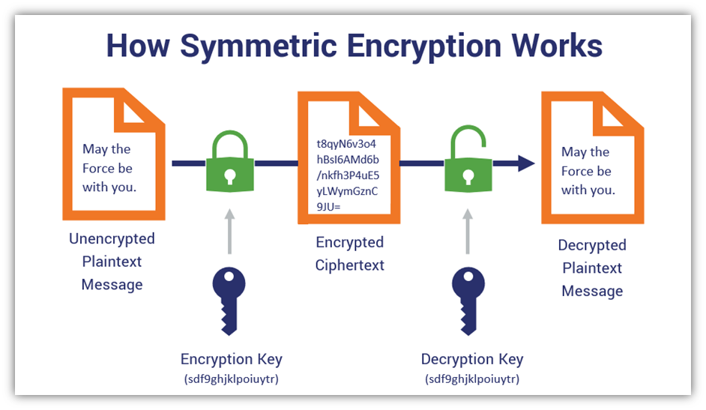
During the symmetric encryption that takes place when you connect securely to a website, you’re using a bulk cipher to make that happen. There are two subcategories of bulk ciphers: block ciphers and stream ciphers.

Slide 5
The Most Common Symmetric Algorithm
Data Encryption Standard (DES)
Triple Data Encryption Algorithm (TDEA)
Advanced Encryption Standard (AES)
Blowfish Algorithm
IDEA Algorithm

Slide 6
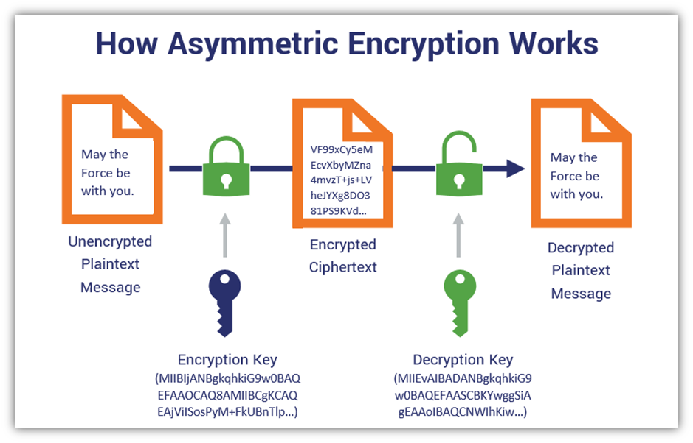

Slide 7
Asymmetric encryption also offers:
Authentication —Asymmetric encryption helps you to verify identities in a way that no one can fake or contest (this is known as non-repudiation), which makes this process is ideal for encrypting data between third parties who don’t know each other.
Secure Key Exchanges — Asymmetric key exchange protocols facilitate symmetric key exchange (more on that a little later) via public channels that are otherwise susceptible to man-in-the-middle (MitM) attacks.
Data Integrity — Offers assurances that your data hasn’t been altered or modified through the use of digital signatures.

Slide 8
WHAT IS THE DIFFERENCE BETWEEN SYMMETRIC KEY CRYPTOGRAPHY AND ASYMMETRIC KEY CRYPTOGRAPHY?

Slide 9
WHAT ARE THE ADVANTAGES AND DISADVANTAGES OF SYMMETRIC AND ASYMMETRIC KEY CRYPTOGRAPHY?

Slide 10
COMPARISON | SYMMETRIC KEY CRYPTOGRAPHY | ASYMMETRIC KEY CRYPTOGRAPHY
Basic | Symmetric encryption uses a single key. | Asymmetric encryption uses a different key for encryption and decryption.
Performance | Symmetric encryption is faster in execution. | Asymmetric Encryption is slow in execution.
Algorithms | DES, 3DES, AES, and RC4. | Diffie-Hellman, RSA.
Purpose | Symmetric encryption is used for bulk data transmission. | Asymmetric encryption is often used for securely exchanging secret keys.

Slide 11
CONCLUSION
As a simple and fast encryption method, asymmetric encryption is commonly used to exchange passwords, and symmetric encryption, which is a faster technique, is used for bulk data transfer.

Slide 12
TASK
Difference between Symmetric and Asymmetric key Cryptosystems
Write note on “Public Key Cryptography Requirements”
Difference between private and public key

